Slide 1
Crafting Connections: Mastering the Art of Networking for Job Development Success in the Digital Age
Presented by:
Optional Wave

Slide 2
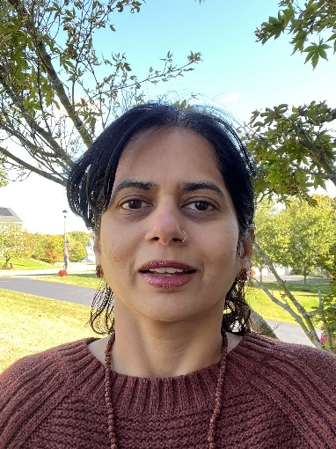
Today’s Presenters
Terry Holmgren
Employer Liaison
SSCE
Rupali Potnis
Sr Project Coordinator
CMEC
Christine Ventulett-Buckley
Sr Project Coordinator
WMEC
Amanda Amaral
Employer Liaison
NEEC

Slide 3
Terry Holmgren
Terry joined the Institute for Community Inclusion in April 2024 as the Employer Liaison for the South Shore Collaborative on Employment. With experience since 2009, Terry has supported individuals with disabilities in various employment-focused roles. Most recently, Terry worked at Triangle Inc. as the Business Engagement Manager and holds a bachelor’s degree in Psychology from Merrimack College..

Slide 4
Who We Are
At the Riverside Employment Collaboratives, and ICI, we work closely with service providers and state agencies dedicated to helping individuals with disabilities find meaningful employment as well as employers who support Diversity and Inclusion on their workforce. Our mission is to increase meaningful employment outcomes for individuals with disabilities.
Our work is to empower our partners by providing tools, resources, and to facilitate a collaborative network resulting in employment offers. Supported by DDS and DMH, we aim to break down barriers and create inclusive pathways to employment.

Slide 5
Improving Pathways through the Job Developers Network
JDN
Employer Partners
Service Providers
Technology Resources
Trainings Programs & Community Impact

Slide 6
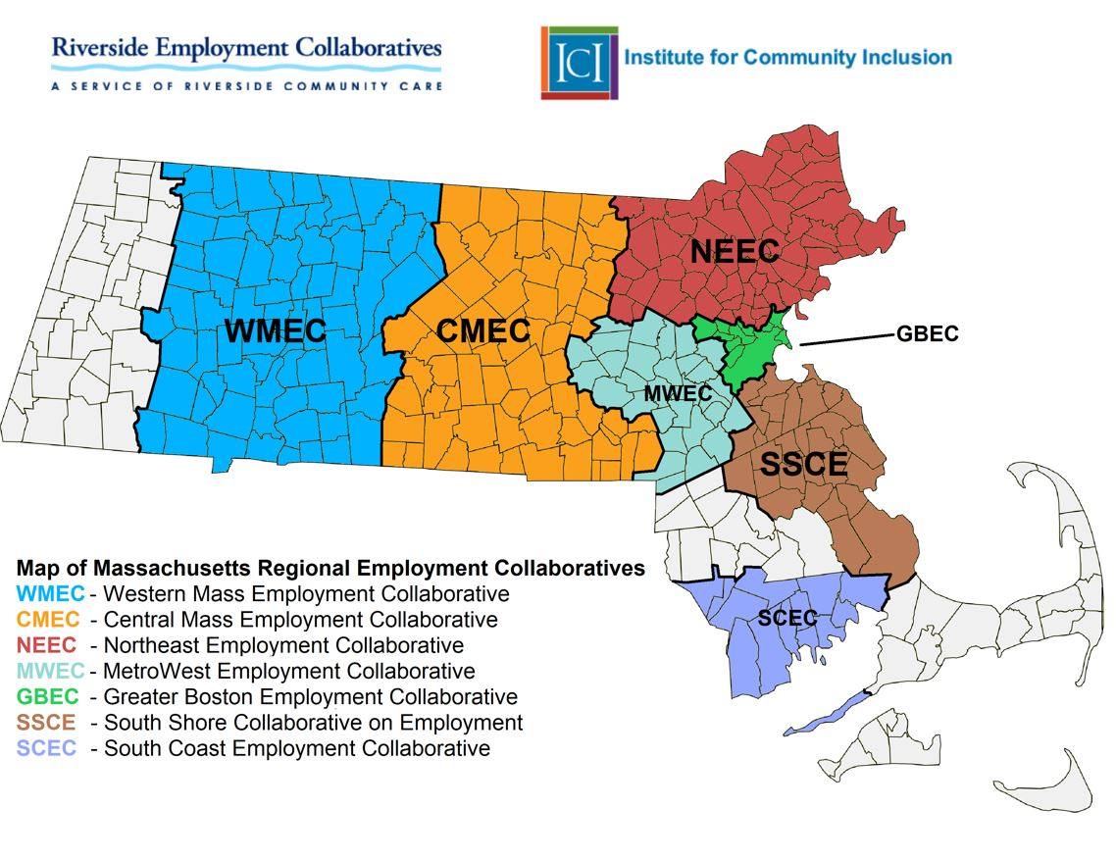
Massachusetts Regional Employment Collaboratives

Slide 7
What you’ll learn
Learning Objectives:
Develop and apply effective networking techniques in both traditional and digital professional settings
Craft and deliver a compelling elevator pitch to make lasting impressions in person and online
Leverage collaboration strategies and AI-powered tools to expand personal and client networks

Slide 8
Networking – What is it?
Networking is the process of making connections and building relationships.

Slide 9
Networking – What is it?
Some of the skills needed for networking:
Communication skills
Confidence
Active Listening
Building Relationships
Empathy
Following up
Other skills that are helpful:
Friendliness
Respect
Positivity
Humor (depends on the situation)
Nonverbal communication such as
body language, and facial expressions

Slide 10
Rupali Potnis
Rupali Potnis is the Senior Project Coordinator at the Central Mass Employment Collaborative, with over 11 years of experience supporting individuals through employment services. She has a background in Human Resources and is passionate about wellness, yoga, and cooking.

Slide 11
In-Person Networking Opportunities
Job fairs/hiring events/org events
Community events
Places of worship
Family/friends gatherings
Conferences
Parties

Slide 12
Tips and tricks for In-Person Networking
Research, prep and develop a strategic approach to networking to build relationships.
Have a clear goal
Practice on conversation starters
Ask people about themselves
Follow appropriate networking etiquettes
Be an active listener
Ask appropriate questions
Collect contact information
Goal should be to build relationships
Follow up

Slide 13
Tips and tricks for In-Person Networking
Network with the right people. It’s not about what you know, but who you know
Look for people who are knowledgeable, influential, helpful
Focus on Quality and NOT Quantity of people you know
Create more connections both inside and outside your organization
Wondering where to start networking, tap into your dormant connections
Be the gate keeper of who you want to include in your inner circle
Network throughout your entire career

Slide 14
Using Social Media for Networking
Social media has revolutionized networking
Building connections around the world
Avoid the anxiety of meeting someone in person
Gain insights from a diverse range of people
Strengthen our networks
Increase visibility of ourselves / our work to a broader audience

Slide 15
Choosing the Right Social Media Platform for Networking
Traditional- LinkedIn, Facebook, X (formerly Twitter), Threads
Image based - Instagram, Snapchat, Pinterest
Video based – YouTube, TikTok, Instagram Reels
Community based - Discord, Facebook groups, Patreon, Slack
TIP!!!!! Choose the platform that supports your goal!!

Slide 16
Leveraging LinkedIn for Networking
“Your network is the people who want to help you, and you want to help them, and that’s really powerful” - Reid Hoffman, founder of LinkedIn
World's largest professional network
Most trusted and reliable
Professional growth and career advancement
Find the right job or internship
Learn the skills you need to succeed in your career
Showcase your skills and experience
Used by Recruiters to look for top candidates
Your built-in Resume is visible to all

Slide 17
Use Social Media –But Play It Safe
Tips
Keep your private and business accounts separate
Good practice to keep the account’s settings to Private
Post specific content for specific audience
Avoid posting offensive/inappropriate content
Represent yourself professionally on professional platforms
Remember once you put anything online it STAYS and is VISIBLE TO ALL!!

Slide 18
Use Social Media –But Play It Safe
Risks
Cyberbullying
Invasion of privacy
Scams
Addiction to social media
Reduces in-person connections
Reputation damage due to inappropriate posts

Slide 19
Informational Interviews
Valuable technique for exploring potential careers by asking experienced professionals about their career paths and expertise.
Informal setting
Low pressure
Focused on networking, collecting information and learning about a specific career field, industry, school, etc.
Gain insider information
Develop meaningful relationships
Enhance and build confidence for interviewing skills

Slide 20
Christine Ventulett-Buckley
Christine Ventulett-Buckley is the Sr. Project Coordinator/Employer Liaison for WMEC at Riverside Community Care and manages CVS retail and Culinary Foundations training programs. She has a background in vocational rehabilitation and occupational therapy, with extensive experience supporting individuals with disabilities in achieving employment success.

Slide 21
Creating an Effective Elevator Pitch is Key to Networking Success
What is an Elevator Pitch?
Why is it important?
When to use it?

Slide 22
Elements of a Compelling Elevator Pitch
Introduction: Who are you?
What You Do: Summarize your expertise, job title, and education
What makes you unique: What skills, experiences & assets do you have?
Make the Connection: How do you fit in with what they are looking for? *Need to know about them and what they do/ want
Call to Action: End with a question, request or invitation to connect further. Make a specific, direct, clear ask and make sure you know next steps.

Slide 23
Tips for an Effective Elevator Pitch
Tailor it to your audience
Know your goal
Highlight what makes you unique
Practice & refine
Time yourself
Use your excited voice
Speak slowly and clearly
Use good body language include eye contact, smile and posture
Don’t give them all the details… Leave them intrigued
Get their info and definitive next steps

Slide 24
Writing your Elevator Pitch and Use Chat GPT to Polish it 10 Minutes
Intro: “Hello, I’m [Your Full Name]. Currently, I am a [Your Current Role/Status].”
Skills, experiences & assets What makes you unique? “I bring [X years ] of experience in [Your Field/Industry].”
"My strengths are in [2-3 Key Skills relevant to the job]."
"Recently, I accomplished [Significant Achievement or Project], leading to [Positive Outcome].“
"I’m seeking to [Your Career Goal] within a company that [What You're Looking For in a Company]."
"I believe my abilities in [Relevant Skills] can help [Solve a Problem or Add Value] for your organization."
"I would appreciate the chance to discuss opportunities in [Specific Role or Department] at your company. Do you have a few minutes to chat?" It needs to be a specific, direct, clear ask.

Slide 25
Amanda Amaral
Amanda Amaral is the Employer Liaison for the Northeast Region at Riverside Community Care. She has over 14 years of HR experience in onboarding, Amanda Amaral is the Employer Liaison for the Northeast Region at Riverside Community Care. She has over 14 years of HR experience in onboarding, recruiting, and DEI, and holds an MBA from UMass and a Bachelor's in Education from Anna Maria College. She is passionate about helping others learn and grow.

Slide 26
Digital Organization
The Digital age is inevitable, it is everywhere we go.
There are so many tools out there, that can help you stay organized, find info you may not have, help you write those intro emails, and lots of other neat tools!
Digital Business Cards
Using AI to find contact info
Rec’s Employment Guide
Notes:
The Digital age is inevitable, it is everywhere we go. As we have already heard from both Rupali, and Christine, social media, and AI are in our every day lives. With the help from Nicole, our digital mastermind,

Slide 27
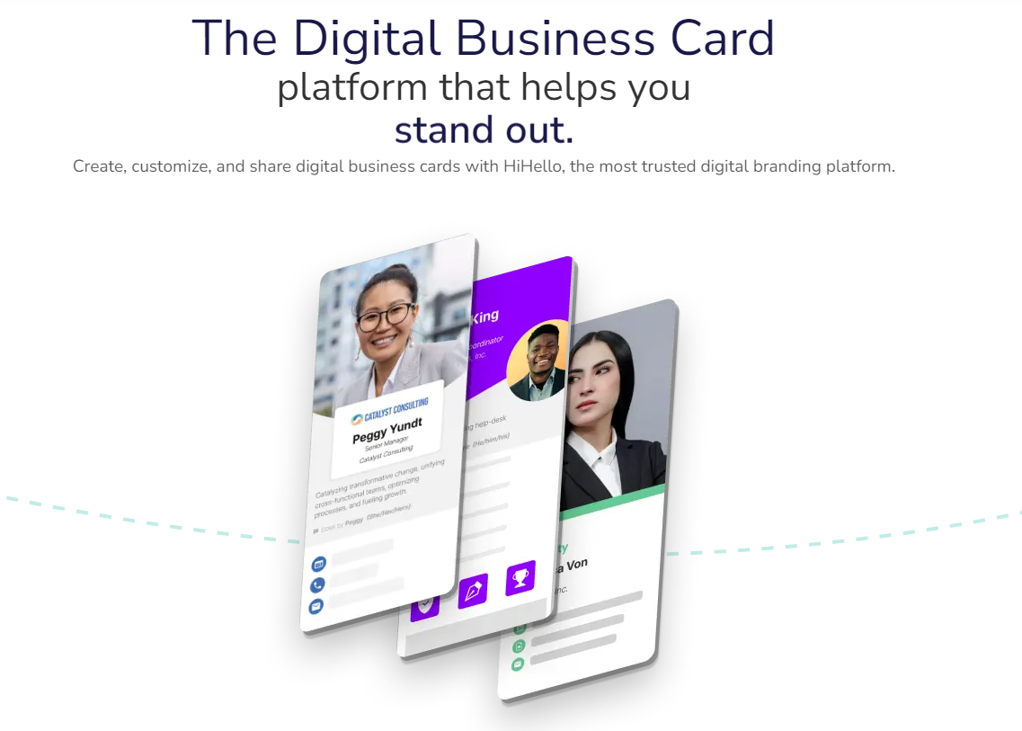
Digital Business Card
Notes:
The Digital age is inevitable, it is everywhere we go. As we have already heard from both Rupali, and Christine, social media, and AI are in our every day lives. With the help from Nicole, our digital mastermind,

Slide 28
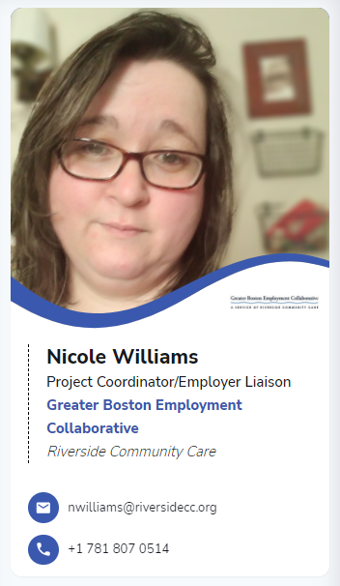
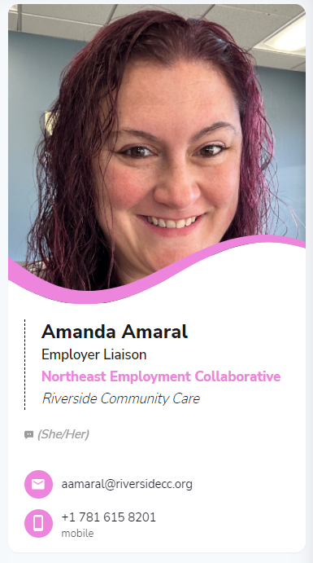
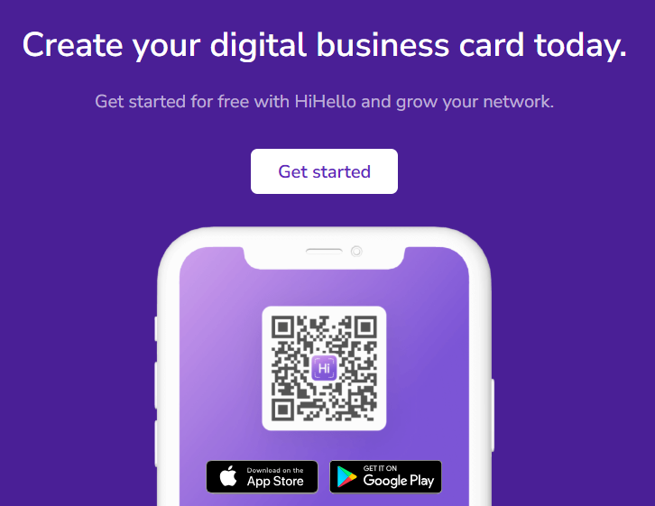
Digital Business Card
Notes:
The Digital age is inevitable, it is everywhere we go. As we have already heard from both Rupali, and Christine, social media, and AI are in our every day lives. With the help from Nicole, our digital mastermind,

Slide 29
Using AI to Find Contact Info
Using AI to help you find contact information
can be as simple as a click, or prompt.

Slide 30
Using AI to Find Contact Info

Slide 31
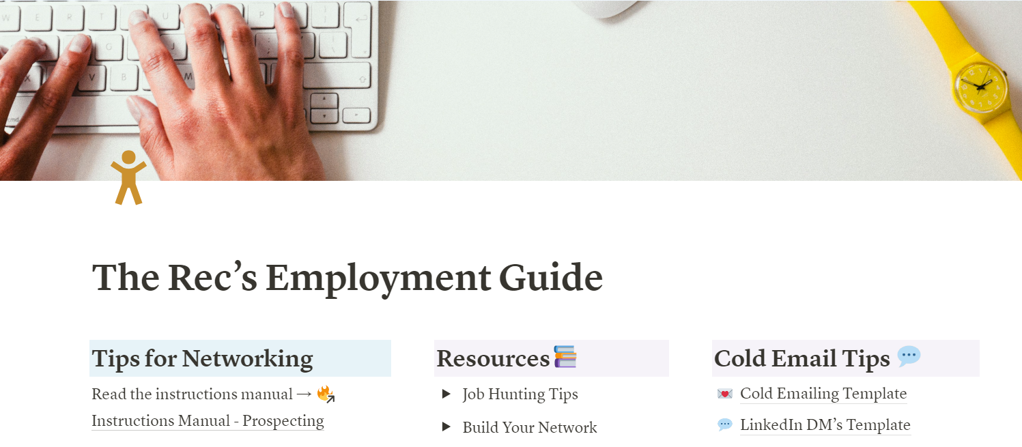
Staying Organized
Introducing "The Rec's Employment Guide," a valuable resource crafted by Nicole for career professionals to enhance their support for clients in leveraging technology for effective job searching and networking.
Notes:
This comprehensive Notion template serves as a one-stop guide, offering:
Elevator Pitch Template: Empower your clients to craft a compelling introduction that effectively communicates their unique strengths and value.
AI-Powered Tools: Equip your clients with cutting-edge AI technology to optimize their job search process, ensuring smarter and more efficient applications.
Contact Tracker: Help clients maintain organized networking efforts, ensuring timely follow-ups with their professional connections.
Job Search Tracker: Provide a streamlined method for clients to monitor job applications, keeping track of progress and key deadlines.
Benefits
This Employment Guide offers several advantages:
It provides a structured approach to the employment process, ensuring no crucial steps are overlooked.
The template is customizable, allowing users to tailor it to their specific needs and circumstances.
It serves as a central hub for all employment-related information and activities, promoting organization and efficiency.

Slide 32
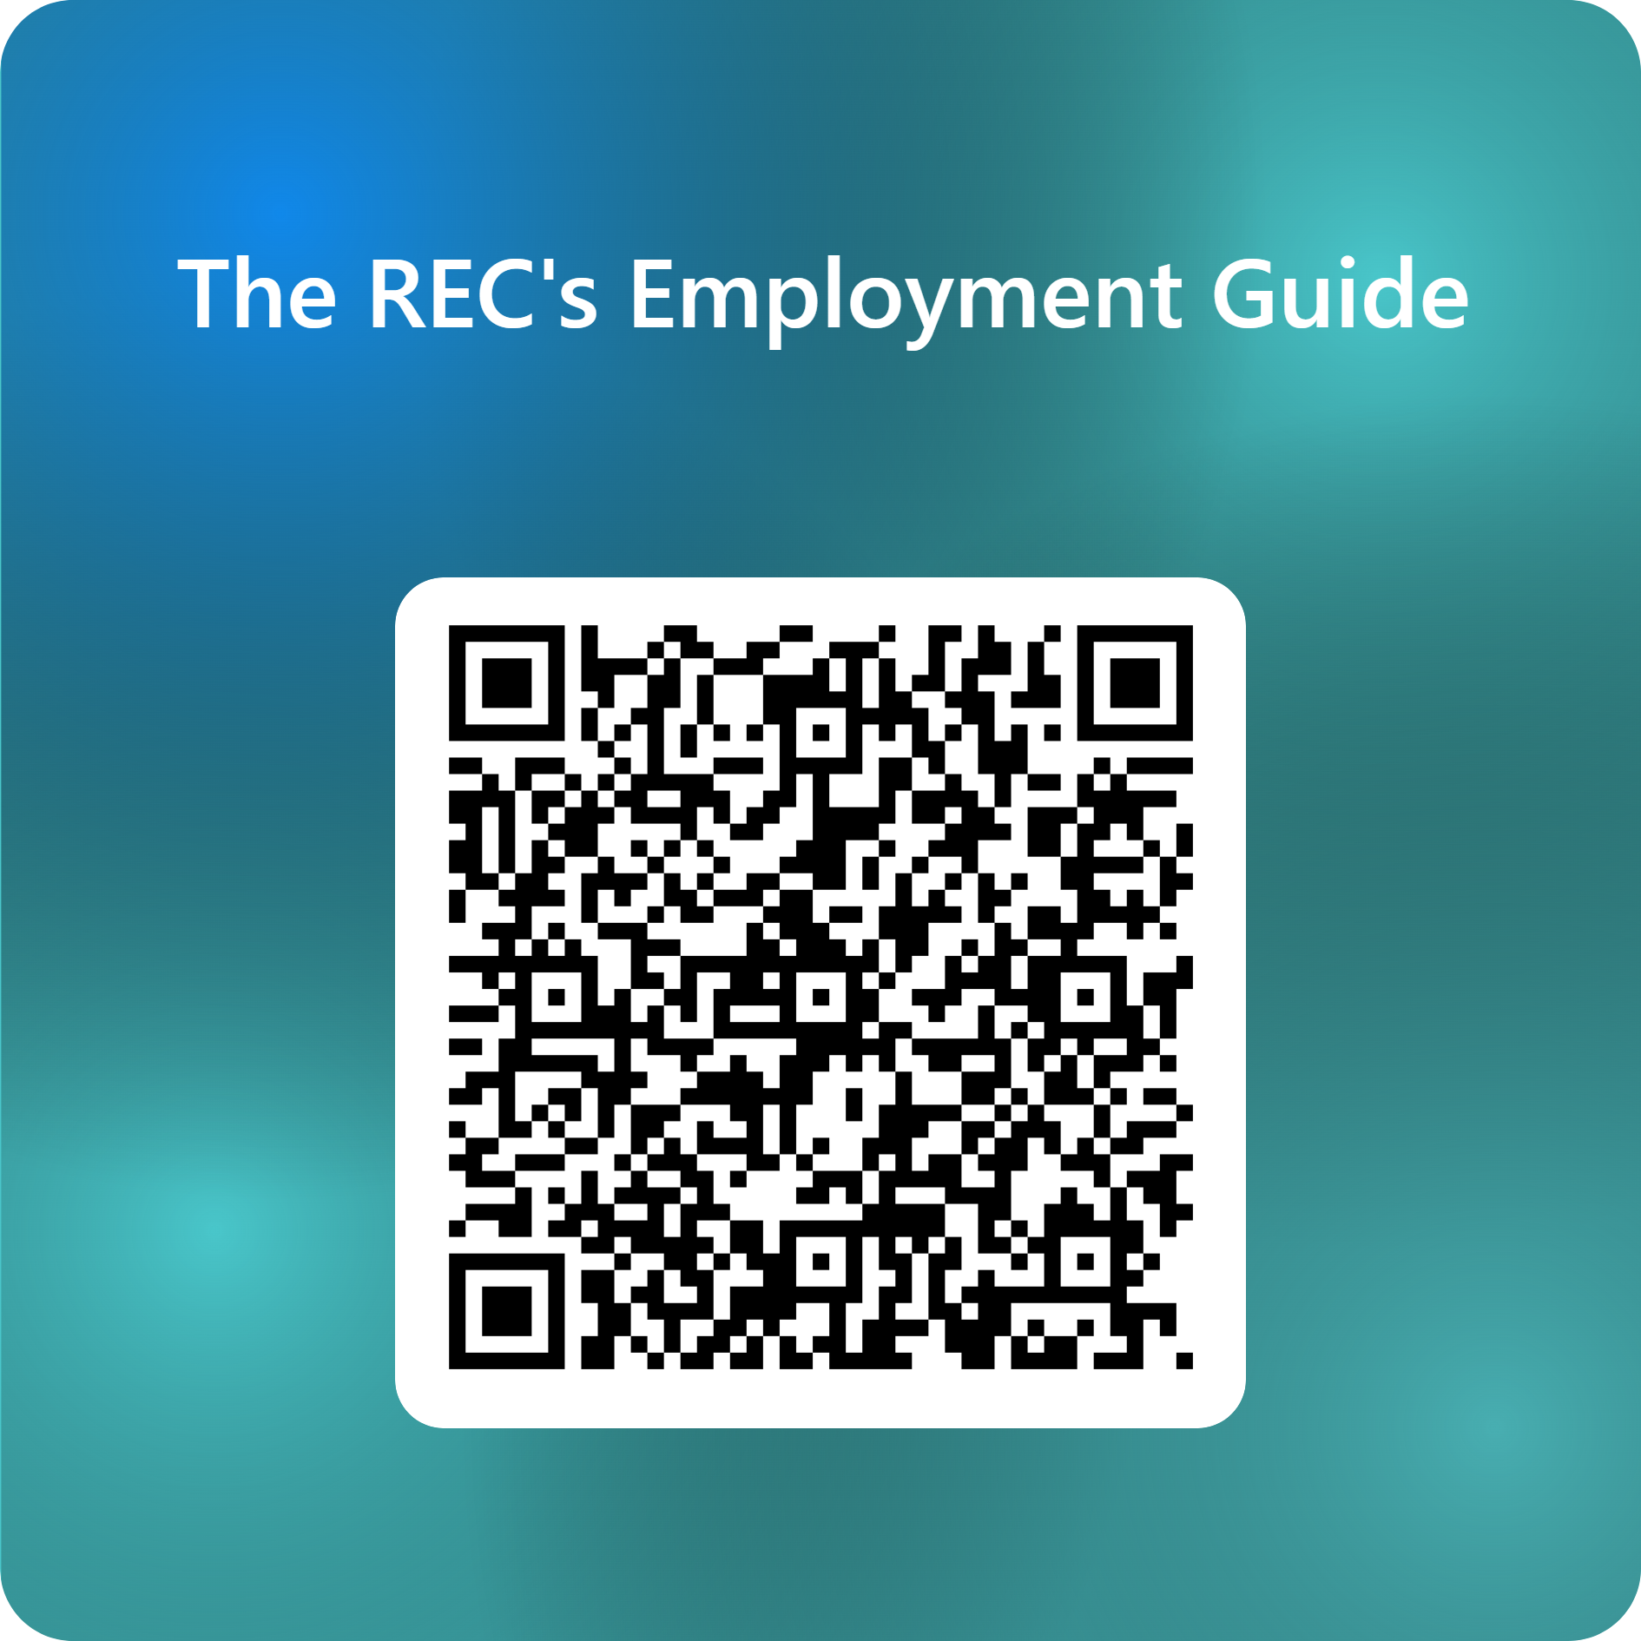
Staying Organized
If you would like a copy of the template we just demonstrated, please register here, and we will email it directly to you!

Slide 33
“
- Source
Optional Wave

Slide 34
Open to Questions!
Thank you for attending today’s workshop on how various digital tools can help you in your networking efforts!
Optional Wave

